Slide 1
PREDICTION OF EPIDEMIC OUTBREAK IN A REGION USING MACHINE LEARNING
Presented by
CH.SREYA
D.PAVANI
O.KUJITHA
20RH1A6617
20RH1A6619
20RH1A6647

Slide 2

AGENDA
Abstract
Problem Statement
Introduction
Existing System
Proposed System
Methodology
Future Work Scope
Conclusion

Slide 3

ABSTRACT
The epidemic disease had become the most dangerous disease for the 21st Century.
Epidemic diseases are contiguous diseases that are possible to be spread into entire nation if the contagion measurement had reached the outbreak level.
In this work we propose a predictive model to predict the status of the epidemic in the specific region.
For experimental purpose we collected data from EHR(Electronic Health Record).

Slide 4

INTRODUCTION
The epidemic disease had become the most dangerous disease for the 21st Century.
India also had experienced some of the epidemic diseases outbreak such as COVID-19, dengue, hepatitis, chikungunya and many more.
In this work, we propose a predictive model to predict the status of the epidemic in the speciﬁc region.

Slide 5

PROBLEM STATEMENT
In this work, we propose a predictive model to predict the status of the epidemic in the speciﬁc region. For the experimental purpose, we collect the data from EHR (Electronic Health Record) as well as from the social media such as Twitter and Facebook.
This Photo by Unknown author is licensed under CC BY.

Slide 6
EXISTING SYSTEM
The status of epidemic in a region is known previously by the number of patients admitted in hospitals in that region but, this prediction is not accurate.

Slide 7
PROPOSED SYSTEM
The use of dataset helps to ﬁnd the status of epidemic in a region accurately without having contact with other person preventing further spreading of disease.
To apply machine learning algorithms on dataset.
To be able to detect and predict the epidemic diseases.
To be able to know percentage of infected people per area. Counter measures on infected areas based on the predictions.

Slide 8


METHODOLOGY
Python libraries like python, NumPy, matplot will be used for the development and experimentation of the project.
Tools such as Anaconda Python, and libraries such as Kera's will be utilized for this process.

Slide 9
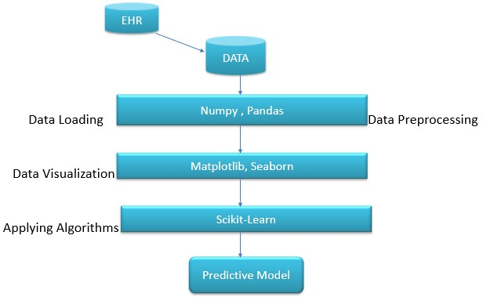
ARCHITECTURE:

Slide 10
FUTURE WORK SCOPE
Predicting future outbreaks and understanding how they are spreading from location to location can improve patient care provided. Our predictive model provides insight that can ultimately give hospitals a stronger warning.
Knowing how a disease spreads would give health oﬃcials a better chance to maintain good health among citizens. The predictions provide forecasting for one week in advance.

Slide 11
THANK YOU

